Slide 1
Exploring the Landscape of Fairness Interventions in Software Engineering

Slide 2
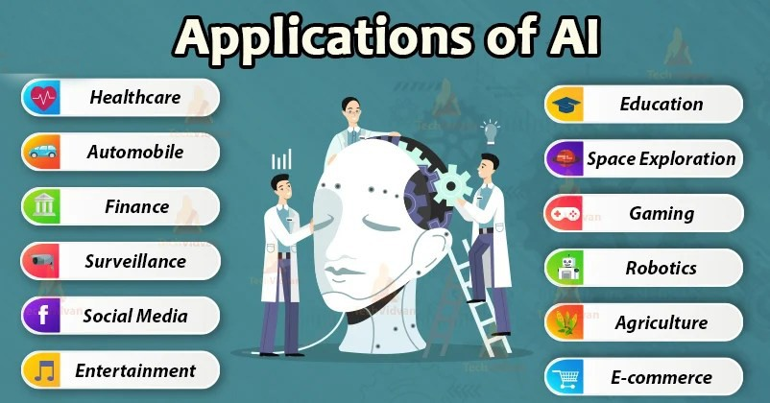
Introduction
AI is being integrated in various applications through Software Systems
Reduces human effort & achieve faster results

Slide 3
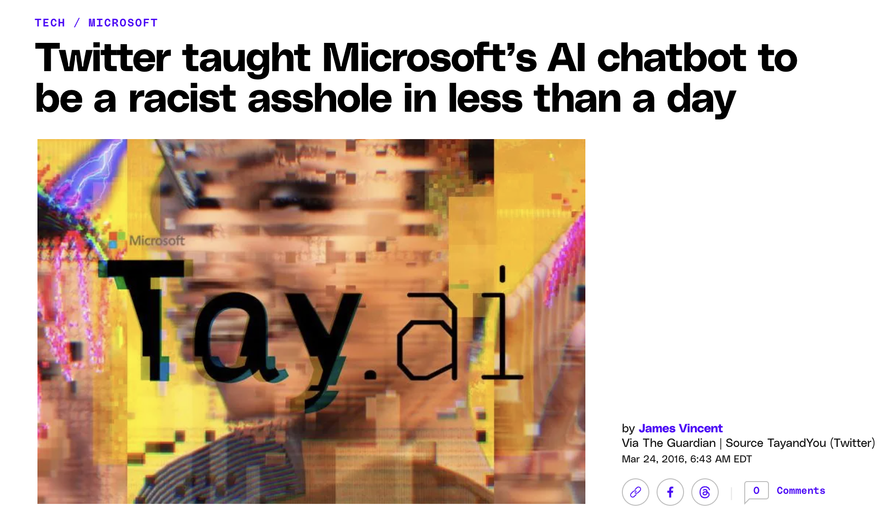
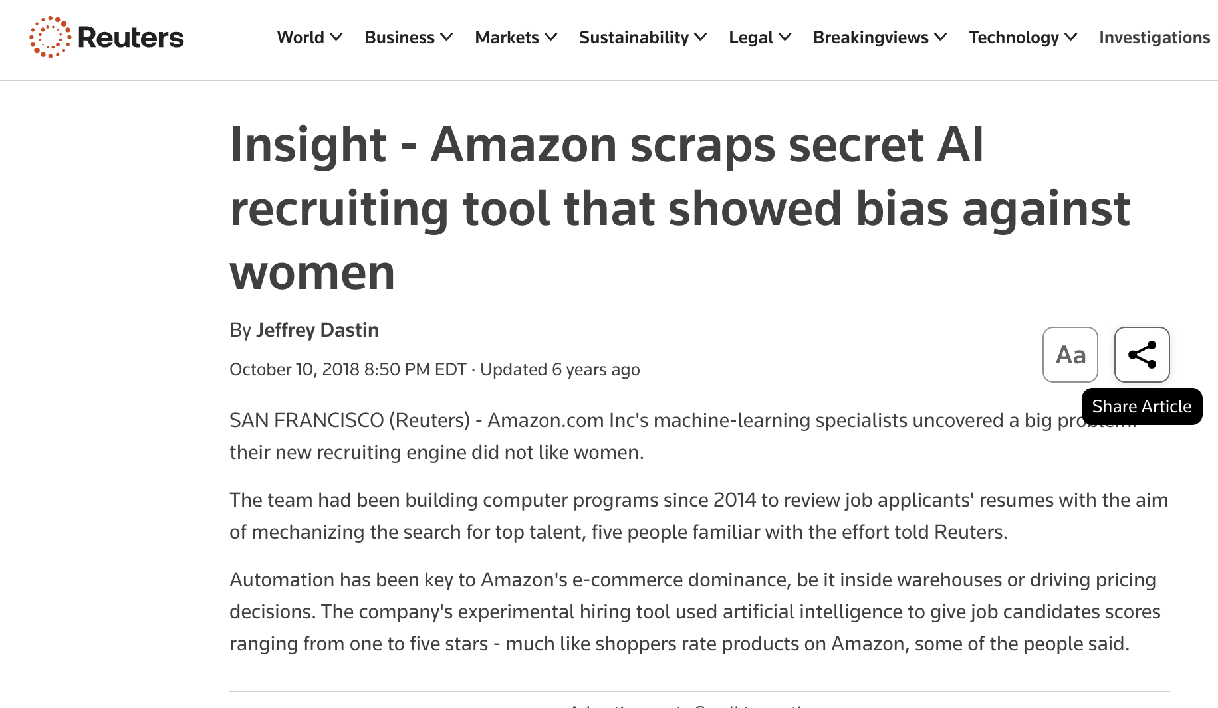
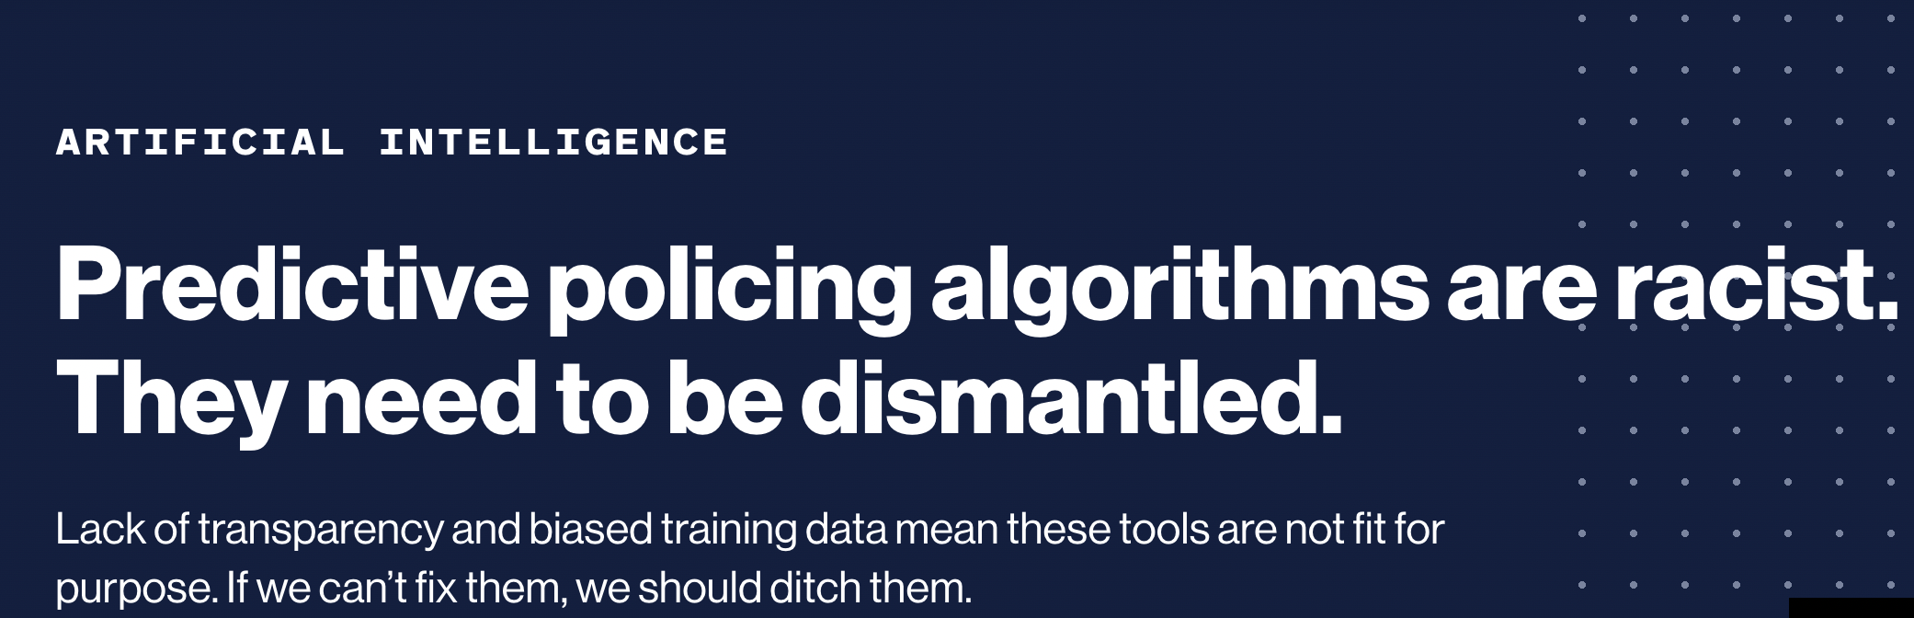
Background: Bias in AI-Driven Software Systems

Slide 4
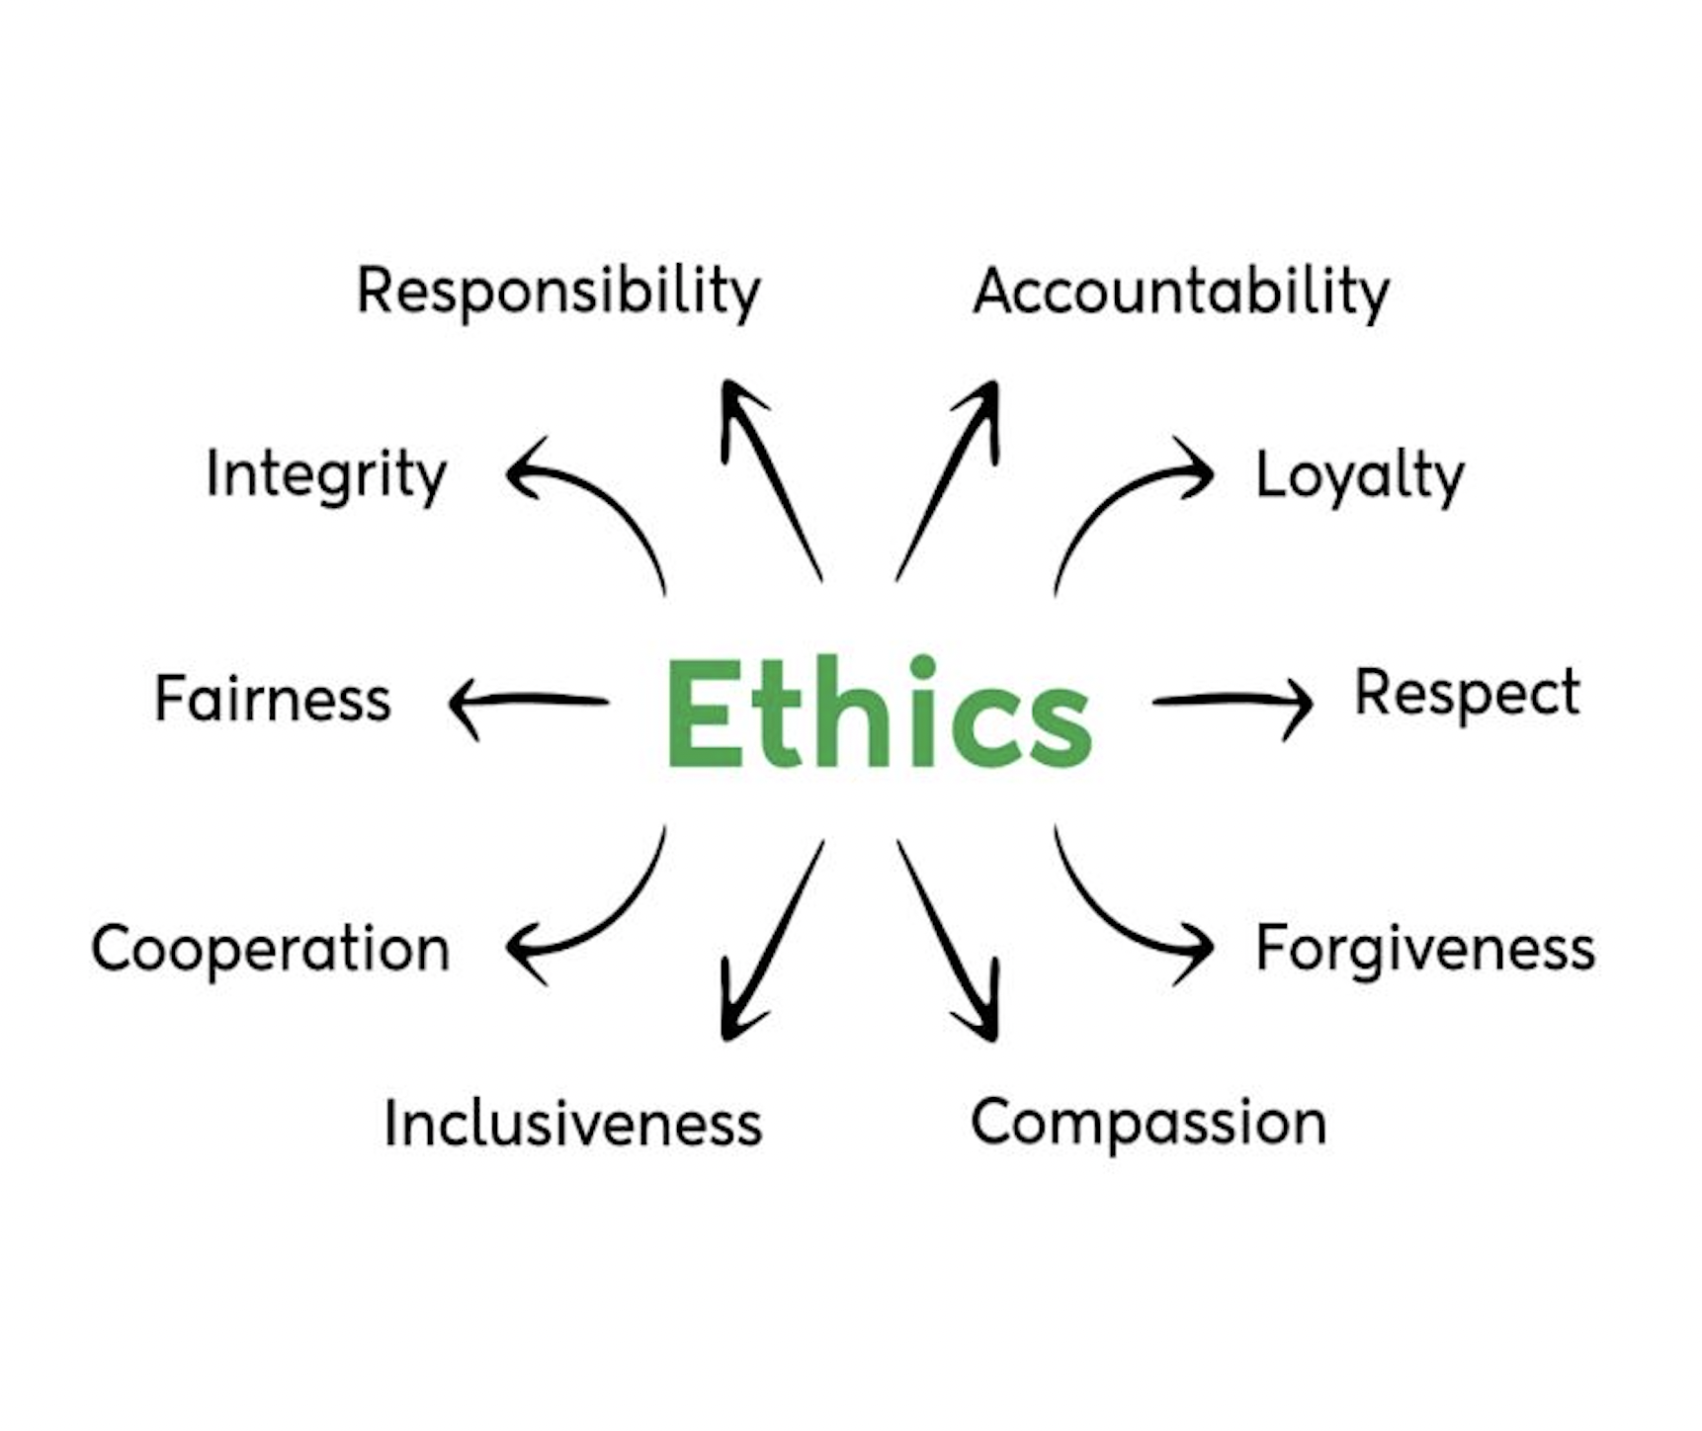
Background: Fairness VS Ethics
Ethics involves broader moral principles about what is right or wrong.
Focus: Morality, responsibility, and the societal impact of decisions or actions.
Fairness refers to treating all individuals or groups equitably and do not disadvantage people based on sensitive attribute (e.g., race, gender, age)
Focus: Procedural or outcome-based equality

Slide 5
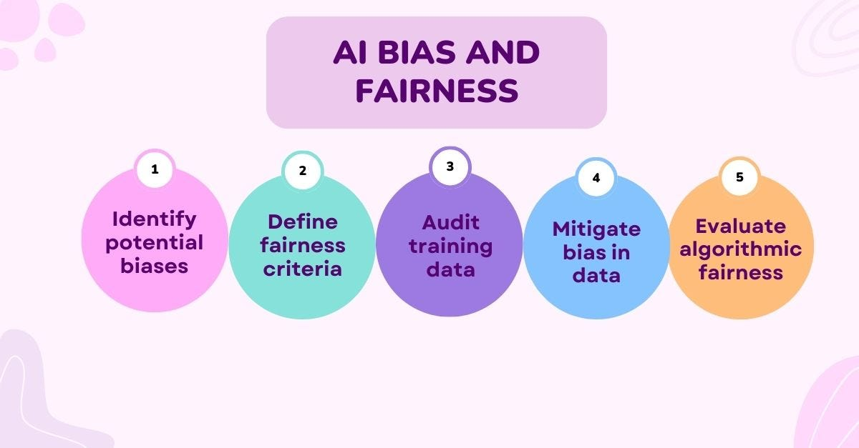
Background: Fairness Principles in AI-Driven Software
Software Fairness is analogous to Software Quality

Slide 6
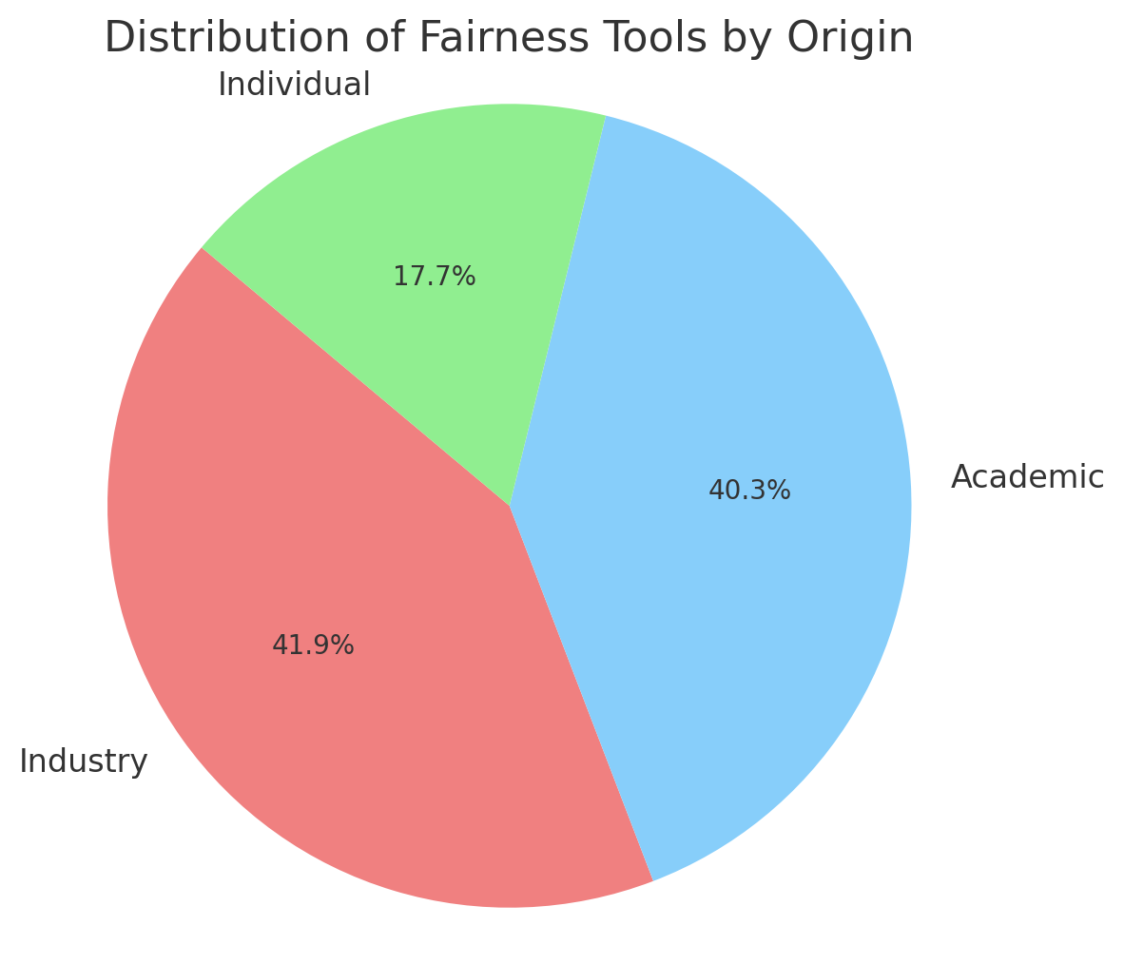
Background: Open Source Fairness Tools
Software solution to help practitioners to detect & mitigate bias in their model through systematic approach
Efforts have been found around
Industrial
Academic
Individual

Slide 7
Taxonomy of Existing Literature
Related Literature to Ethics & Fairness
Ethics & Fairness in Software Systems
Ethics & Fairness in AI driven Software System
Conducted User Studies for Fair Software System
Practice & Ignorance in Ethical Software Engineering
Tools for Ethical Software Systems
Fairness Principles in AI-Driven Software
Tools for AI Fairness in Software
User study on Fairness Guidelines
User study on Fairness Tools

Slide 8
Practice of Fairness & Ethics in Software
Promotes DEI in software engineering practices, addressing challenges and solutions for minority groups within the IT industry[1].
Highlights the ethical aspects in data-driven software & showed gaps in existing works[3].
Study on the existing prejudice on relationship among fairness & dataset & feature size[4].
Vision for software engineering research to promote fairness by addressing ethical issues, throughout various phases of software development[2].
Exploratory studies related to ethical software engineering & DEI practices
[1] D. Damian, K. Blincoe, D. Ford, A. Serebrenik, and Z. Masood, Equity,Diversity, and Inclusion in Software Engineering: Best Practices andInsights. Springer Nature, 2024.
[2] Y. Brun and A. Meliou, “Software fairness,” in Proceedings of the 201826th ACM joint meeting on european software engineering conferenceand symposium on the foundations of software engineering, pp. 754–759, 2018.
[3] B. Johnson and J. Smith, “Towards ethical data-driven software: fillingthe gaps in ethics research & practice,” in 2021 IEEE/ACM 2nd International Workshop on Ethics in Software Engineering Research andPractice (SEthics), pp. 18–25, IEEE, 2021.
[4] J. M. Zhang and M. Harman, “” ignorance and prejudice” in software fairness,” in 2021 IEEE/ACM 43rd International Conference on SoftwareEngineering (ICSE), pp. 1436–1447, IEEE, 2021.

Slide 9
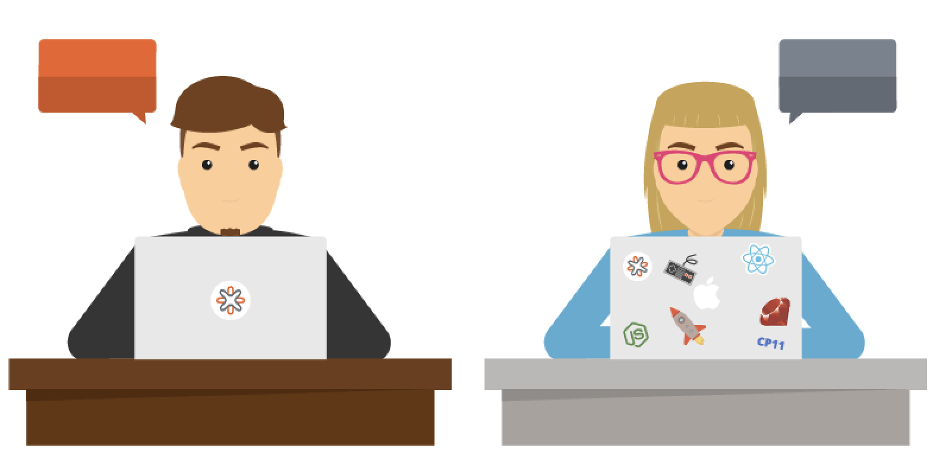
Implications
Inclusivity must extend beyond the user interface to team composition
Even with large datasets, a limited feature set can worsen existing biases
Software evaluation must have both external and internal evaluation to create increasingly sophisticated and morally sound system
The incremental IEEE/ACM Workshop on Software Fairness are evidence of the software engineering community’s enhancing participation in fairness

Slide 10
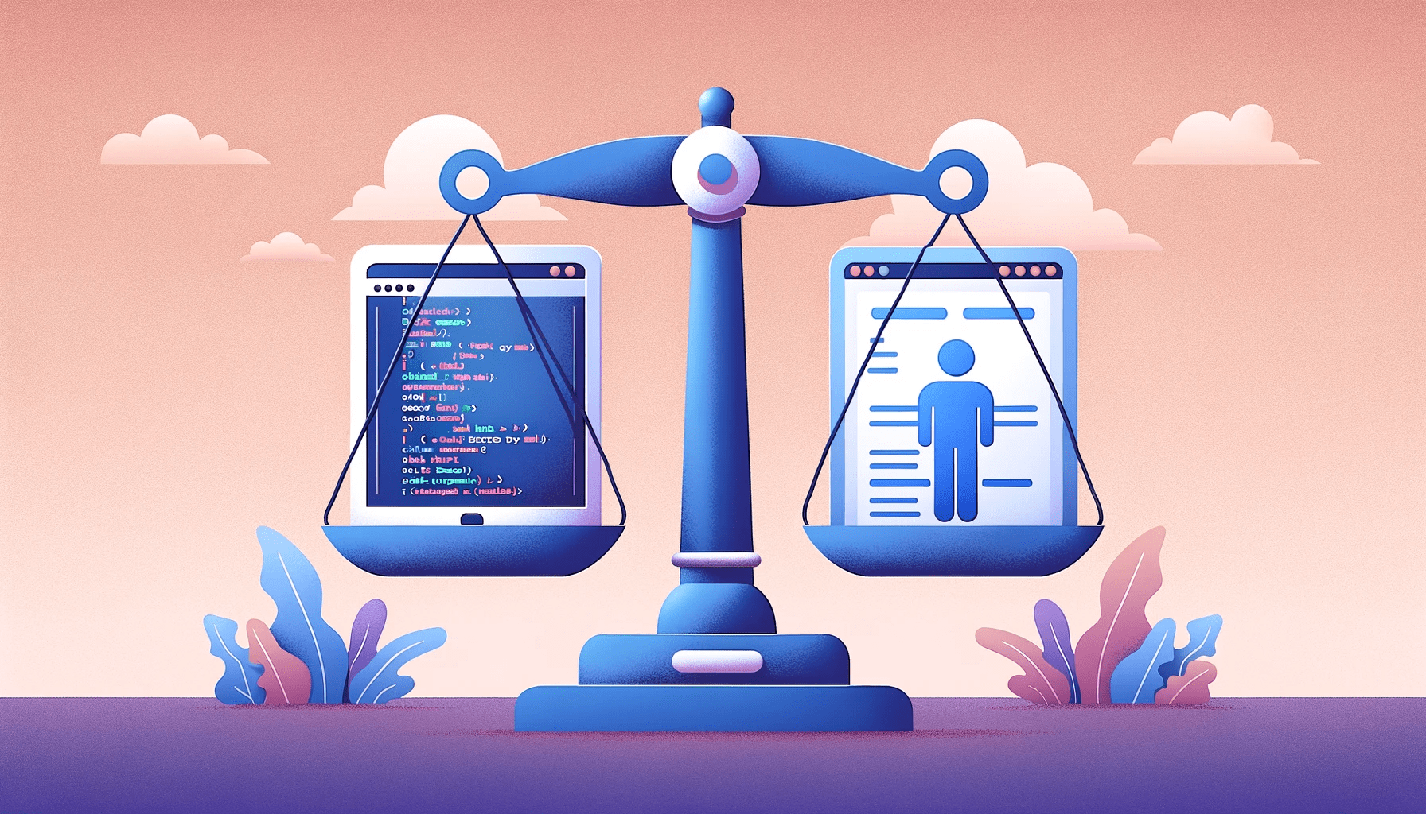
Testing Tools for Ethical Software Development
FairTest that helps developers detect and debug unfair treatment in data-driven applications by analyzing associations between outcomes and sensitive user attributes[5].
Themis, a framework for fairness testing that generates test suite to measure individual discrimination in software systems [6].
Extended Themis [6] to Themis v2.0, where they generates test suite for both group & individual discrimination in software systems[7].
Example interventions for fairness through software testing
[5] Tramer, Florian, et al. "Fairtest: Discovering unwarranted associations in data-driven applications." 2017 IEEE European Symposium on Security and Privacy (EuroS&P). IEEE, 2017.
[6] S. Galhotra, Y. Brun, and A. Meliou, “Fairness testing: testing software for discrimination,” in Proceedings of the 2017 11th Joint meeting on foundations of software engineering, pp. 498–510, 2017.
[7].R. Angell, B. Johnson, Y. Brun, and A. Meliou, “Themis: Automatically testing software for discrimination,” in Proceedings of the 2018 26th ACM Joint meeting on european software engineering conference and symposium on the foundations of software engineering, pp. 871–875, 2018.

Slide 11
Taxonomy of Existing Literature
Related Literature to Ethics & Fairness
Ethics & Fairness in Software Systems
Ethics & Fairness in AI driven Software System
Conducted User Studies for Fair Software System
Practice & Ignorance in Ethical Software Engineering
Tools for Ethical Software Systems
Fairness Principles in AI-Driven Software
Tools for AI Fairness in Software
User study on Fairness Guidelines
User study on Fairness Tools

Slide 12
Fairness in AI-Driven Software Systems
Examines ongoing evolution, inherent trust dilemmas across diverse AI applications through case studies & shedding light on open-source best practices[8].
A taxonomy of fairness, discussing fairness assessment methods, identifying bias sources, and examining mitigation techniques[9].
Reviews the causes of unfairness & enhancing mechanism with side-by-side evaluation of different fairness mechanisms across dozens of datasets.
[10].
A comprehensive overview of fairness in machine learning, categorizes fairness solutions in smaller subcategories fairness measurements [11].
Showed taxonomy of 45 existing literatures based on existing fairness metrices, evaluation dataset and mitigation algorithms[12].
Discuss existing literatures for defining fairness terminologies & mitigation techniques
[8] J. Franse, V. Misheva, and D. S. Vale, “Practical and open source best practices for ethical machine learning,” in Towards Trustworthy Artificial Intelligent Systems, pp. 77–84, Springer, 2022.
[9] N. Mehrabi, F. Morstatter, N. Saxena, K. Lerman, and A. Galstyan,“A survey on bias and fairness in machine learning,” ACM Computing Surveys (CSUR), vol. 54, no. 6, pp. 1–35, 2021
[10] D. Pessach and E. Shmueli, “A review on fairness in machine learning,” ACM Computing Surveys (CSUR), vol. 55, no. 3, pp. 1–44, 2022.
[11] S. Caton and C. Haas, “Fairness in machine learning: A survey,” ACM Comput. Surv., vol. 56, Apr. 2024
[12] T. P. Pagano, R. B. Loureiro, F. V. Lisboa, R. M. Peixoto, G. A. Guimar˜aes, G. O. Cruz, M. M. Araujo, L. L. Santos, M. A. Cruz, E. L. Oliveira, et al., “Bias and unfairness in machine learning models: a systematic review on datasets, tools, fairness metrics, and identification and mitigation methods,” Big data and cognitive computing, vol. 7, no. 1,p. 15, 2023

Slide 13
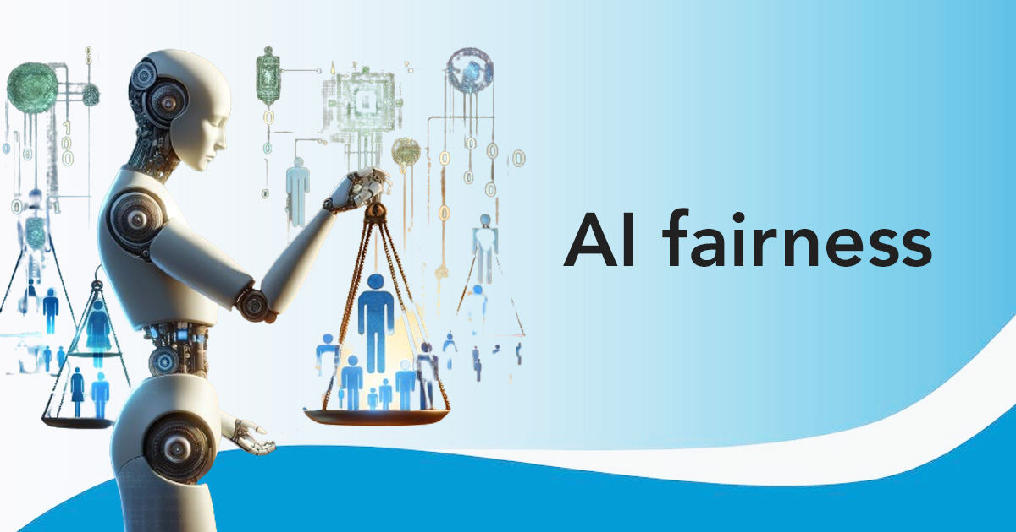
Implications
Ethical practices should adapt to the specific context and use-case rather than applying a
one-size-fits-all approach.
Although group fairness is the most common strategy, it may inadvertently introduce disguised discrimination against apparently privileged groups.
Equality & equity have often been treated as similar concept throughout the literatures which are different concepts.
Needs Human-in-the-loop intervention for fairness assurance.

Slide 14
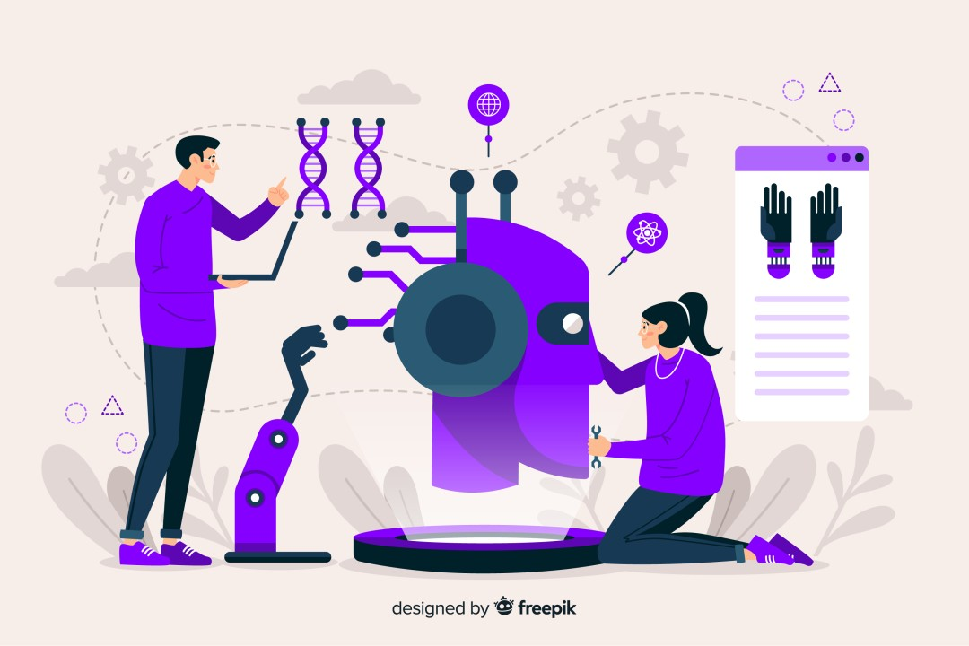
Example of AI-Driven Fairness Tools
Aequitas, an open-source toolkit, simplifies bias and fairness auditing in AI systems by providing intuitive access via command line, python package & web interface[15].
AIF360 comprises 70 fairness metrices and 10 bias mitigation techniques, enabling users to access the tool's extension[13].
Fairkit-learn, built upon Scikit-learn and AI Fairness 360, by optimal search methods to help identify the most suitable fair model for specific datasets[14].
Example of open source tools for fairness in ML-driven systems
[13].R. K. Bellamy, K. Dey, M. Hind, S. C. Hoffman, S. Houde, K. Kannan, P. Lohia, J. Martino, S. Mehta, A. Mojsilovi´c, et al., “Ai fairness 360: An extensible toolkit for detecting and mitigating algorithmic bias,” IBM Journal of Research and Development, vol. 63, no. 4/5, pp. 4–1, 2019.
[14] B. Johnson, J. Bartola, R. Angell, K. Keith, S. Witty, S. J. Giguere, and Y. Brun, “Fairkit, fairkit, on the wall, who’s the fairest of them all? supporting data scientists in training fair models,” arXiv preprint arXiv:2012.09951, 2020.
[15] P. Saleiro, B. Kuester, L. Hinkson, J .London, A. Stevens, A. Anisfeld, K. T. Rodolfa, and R. Ghani, “Aequitas: A bias and fairness audit toolkit,” arXiv preprint arXiv:1811.05577, 2018

Slide 15

Exploratory Study of Fairness Tools
A qualitative analysis of AI ethics toolkits to examine how ethical work is conceptualized, who is expected to do it, and how it is supported [16].
Analyzed 41 fairness testing tools through heuristic evaluation to identify ones for industry suitability[18].
Reviewed the landscape of existing ethical frameworks in terms of impact assessment & audits of the AI development and deployment lifecycle [17].
Author- driven evaluation of existing fairness tools in terms of successful adoption
​
[16]. Wong, Richmond Y., Michael A. Madaio, and Nick Merrill. "Seeing like a toolkit: How toolkits envision the work of AI ethics." Proceedings of the ACM on Human-Computer Interaction 7.CSCW1 (2023): 1-27.​
[17] J. Ayling and A. Chapman, “Putting ai ethics to work: are the tools fit for purpose?,” AI and Ethics, vol. 2, no. 3, pp. 405–429, 2022.​
[18] T. Nguyen, M. T. Baldassarre, L. F. de Lima, and R. de Souza Santos, “From literature to practice: Exploring fairness testing tools for the​
software industry adoption,” in Proceedings of the 18th ACM/IEEE International Symposium on Empirical Software Engineering and Measurement, pp. 549–555, 2024.

Slide 16
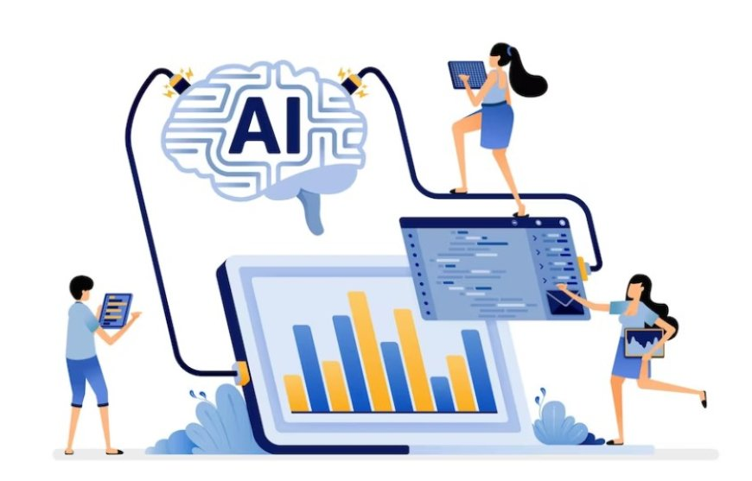
Implications
Despite the abundance of available tools, only a limited number are practically usable.
Support for engaging with stakeholders from non-technical background
Business priorities for AI deployment across market tiers may
destabilize practitioners’ goals for fairness work.

Slide 17
Taxonomy of Existing Literature
Related Literature to Ethics & Fairness
Ethics & Fairness in Software Systems
Ethics & Fairness in AI driven Software System
Conducted User Studies for Fair Software System
Practice & Ignorance in Ethical Software Engineering
Tools for Ethical Software Systems
Fairness Principles in AI-Driven Software
Tools for AI Fairness in Software
User study on Fairness Guidelines
User study on Fairness Tools

Slide 18
User Study on AI-Driven Fairness Guidelines
Interviews with professionals about both traditional and AI-assisted software tools, discussing how trust is established in relation to five key dimensions: Personal, Interaction, Control, System, and Expectations[21].
Reveal open-source ethical concerns surrounding deepfake technology, particularly regarding misuse and the challenges of regulation[19]
Investigated Human+AI Guidelines for building human centered AI culture, and their usage[20]
Shows user studies in AI ethics guidelines for software systems
[19] D. G. Widder, D. Nafus, L. Dabbish, and J. Herbsleb, “Limits and possibilities for “ethical ai” in open source: A study of deepfakes,” in
Proceedings of the 2022 ACM Conference on Fairness, Accountability, and Transparency, pp. 2035–2046, 202
[20] N. Yildirim, M. Pushkarna, N. Goyal, M. Wattenberg, and F. Vi´egas, “Investigating how practitioners use human-ai guidelines: A case studyon the people+ ai guidebook,” in Proceedings of the 2023 CHI Conference on Human Factors in Computing Systems, pp. 1–13, 2023.
[21] [5] B. Johnson, C. Bird, D. Ford, N. Forsgren, and T. Zimmermann, “Make your tools sparkle with trust: The picse framework for trust in software
tools,” in 2023 IEEE/ACM 45th International Conference on Software Engineering: Software Engineering in Practice (ICSE-SEIP), pp. 409–419, IEEE, 2023.

Slide 19
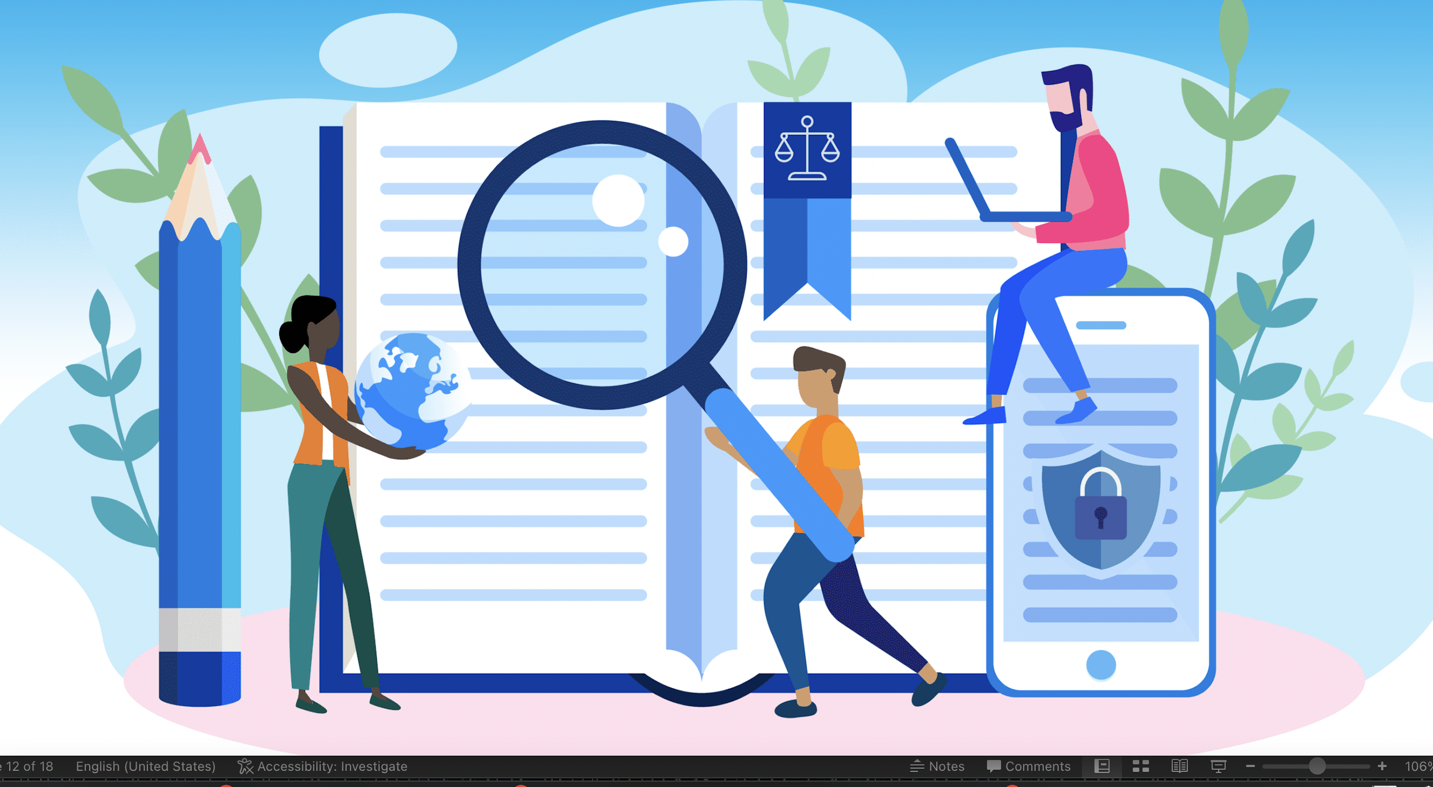
Implication
Community's understanding of ethics is influenced by "Freedom 0" which allows unrestricted use of code, and by beliefs in technological neutrality.
Practitioners use the guidebook not only for addressing AI’s design challenges, but also for education, cross-functional communication.
Practitioners desire more support for early phase ethical problem formulation
It might be more difficult to develop a trustworthy AI-assisted tool in comparison to traditional software tools.

Slide 20
User Study on AI-Driven Fairness Tools
Showed comparative analysis of 6 prominent Fairness tools & identifying gaps in the landscape of existing tools[22].
Evaluated Fairness toolkits in terms of criteria for supporting fairness analysis & optimal tooling with their proposed rubric[24].
On the findings from [22], the study focused on two leading toolkits to explore how industry professionals incorporate them into their workflows and what they expect from such tools23]
Discussed AI practitioners challenges in fairness evaluation, needing improved frameworks, support, and resources[25].
User studies for comparative analysis & practitioner challenges of fairness tools
[22] M. S. A. Lee and J. Singh, “The landscape and gaps in open source fairness toolkits,” in Proceedings of the 2021 CHI conference on human factors in computing systems, pp. 1–13, 2021
[23] W. H. Deng, M. Nagireddy, M. S. A. Lee, J. Singh, Z. S. Wu, K. Holstein, and H. Zhu, “Exploring how machine learning practitioners (try to) use fairness toolkits,” in Proceedings of the 2022 ACM Conference on Fairness, Accountability, and Transparency, pp. 473–484, 2022.
[24] B. Richardson, J. Garcia-Gathright, S. F. Way, J. Thom, and H. Cramer, “Towards fairness in practice: A practitioner-oriented rubric for evaluating fair ml toolkits,” in Proceedings of the 2021 CHI Conference onHuman Factors in Computing Systems, pp. 1–13, 2021
[25] M. Madaio, L. Egede, H. Subramonyam, J. Wortman Vaughan, and H. Wallach, “Assessing the fairness of ai systems: Ai practitioners’ processes, challenges, and needs for support,” Proceedings of the ACM on Human-Computer Interaction, vol. 6, no. CSCW1, pp. 1–26, 2022.

Slide 21
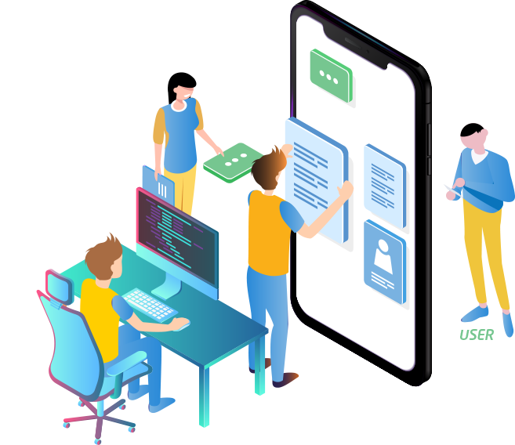
Implication
Steep learning curve to use the toolkits
Limited scope for integrating tools in “Plug & Play” manner
Need support for fostering collaboration with non-technical peers in their organizational settings.
These tools can be a good source for learning about ML fairness concepts and terminologies.

